Slide 1
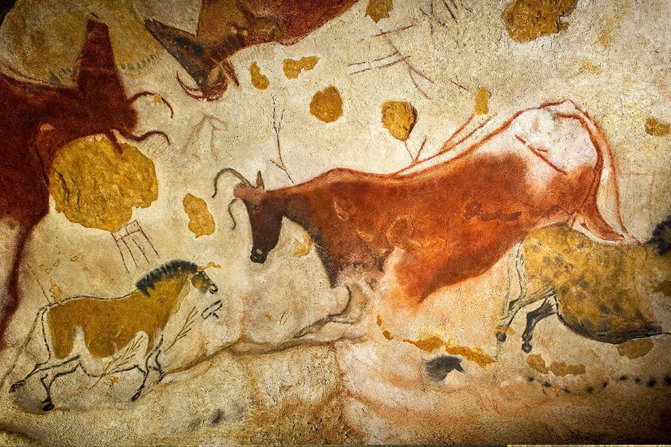
Children compare and group rocks based on appearance and properties. They learn how fossils form and explore soil composition. Investigations include testing rock hardness, permeability, and understanding how rocks change over time
Year 3
Stone Age, Bronze Age and Iron Age
English
Reading fantastic texts like Ug, Stone Age Boy and Stig. We will we explore creative writing, directed speech and use these key text to expand our vocabulary.
We continue to have weekly GPAS lessons with la focus on fronted adverbials, punctuation and various parts of speech.
Reading for pleasure is the lynch pin for allowing ourselves to love all things literature.
French
We will explore different ways to express how we are feeling helping us to take the next step in holding short conversations. We will consolidate our new vocab through our song ‘Ça va?’ using all common responses. Our cultural topic will see us focus on the Epiphany galette tradition.
RE
We explore the ‘Sacrament of Reconciliation’. We will be able to know what happens during the ‘Sacrament of Reconciliation’ and know the gift of forgiveness. We then go onto think about how we can celebrate the Mass. The events surrounding the ‘Last Supper’ and the ‘Sacrament of the Holy Eucharist’.
Maths
This Term, we will cover the following topics:
Fractions
Money
We continue to work hard on our mental arithmetic, having lots of fun on TTRS (Times Tables Rock Stars).
Art and Design Tec
We will have fun creating our own pigments and painting in a ‘Stone Age’ style. We will be inspired by cave paintings and use art to help us tell a story.
During DT we will explore a range building materials and track the improvements in human civilisation with the understanding of various materials and their properties. DT will allow us to design, create and evaluate our own Stig like inventions with inspiration from this wonderful book.
PE
Fun will be had with the start of athletics season with sessions outside on the field.
Inside we will have a chance to create our own gymnastic sequences.
Music
Using our recorders we continue to learn an increased number of notes and start to master the skill of performing for an audience.
We also continue to use and understand musical notation.
Computing
Year 3, children learn how to use technology safely, respectfully, and responsibly. They are taught to keep personal information private and understand the importance of strong passwords. Pupils learn how to recognise and report concerns about content or contact online. The curriculum encourages critical thinking about what they see online and who they interact with.
Geography
This term has a strong emphasis on maps work, coordinates and the skills required to encourage a deeper fascination and curiosity about the world around us.
We also think about how we are global citizens and key environmental issues.
Science
Children compare and group rocks based on appearance and properties. They learn how fossils form and explore soil composition. Investigations include testing rock hardness, permeability, and understanding how rocks change over time.

